Slide 1
Real-Time Heart Attack Prediction using Apache Kafka and Apache Spark
Submitted By: Ayemon Baraka
NSHE ID: 2002163212

Slide 2
Introduction
Heart attack is the number one leading cause of the death for men and women in the US.
Real-time heart attack prediction system can save many lives eradicating the limitation of current detection schemes.
The objective of this project is to develop a real-time system that can predict the likelihood of a person experiencing a heart attack using big data tools and machine learning.
By analyzing the person’s health related data in real-time, the system aims to provide early warnings to healthcare professionals, allowing them to take prompt action and provide better medical care to potentially prevent or reduce the severity of heart attacks.
The dataset used for this project contains various features related to individuals' health
The goal of this project is to utilize Kafka to stream data from a CSV file to Spark, where the machine learning model performed real-time predictions.

Slide 3
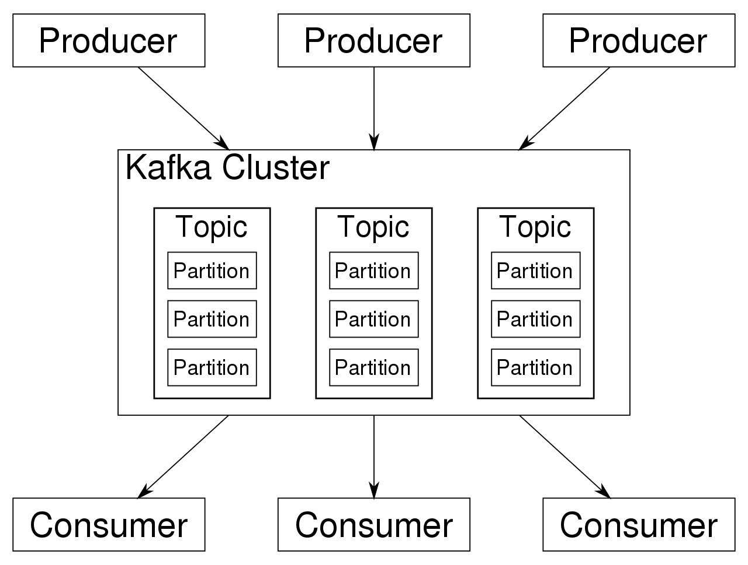
Overview of Apache Kafka
Apache Kafka is a distributed streaming platform that enables the building of real-time data pipelines and streaming applications.
It is designed to handle high-throughput, fault-tolerant, and scalable data streams. Key components of Kafka include:
Topic: A stream of data records, which acts as a channel for data transmission.
Producer: An application that publishes messages to Kafka topics.
Consumer: An application that reads data from Kafka topics.
Broker: The central unit of a Kafka cluster, responsible for storing and managing streams of records.
Zookeeper: Manages distributed coordination between Kafka brokers.

Slide 4

Setup Apache Kafka
Prerequisites: The prerequisites required for setting up Apache Kafka
Java JDK 8 or later.
Running instance of ZooKeeper.
Downloading Kafka:
The Apache Kafka website (https://kafka.apache.org/downloads)

Slide 5
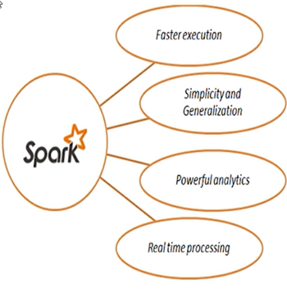
Overview of Apache Spark
Apache Spark is an open-source, distributed data processing engine designed for speed, ease of use, and advanced analytics. Key features of Spark include:
Resilient Distributed Datasets (RDDs): Fault-tolerant, distributed collections of data that can be processed in parallel.
DataFrames: Structured data representation, offering optimization opportunities.
Spark SQL: Enables querying structured data using SQL queries.
Spark Streaming: Allows processing of real-time data streams.
MLlib: Spark's machine learning library, offering various algorithms and utilities for building ML models.

Slide 6
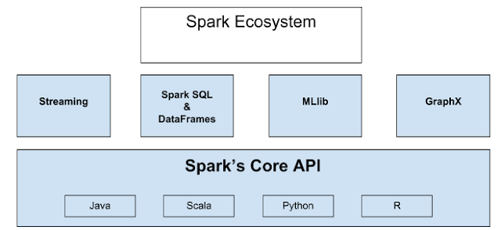

Slide 7
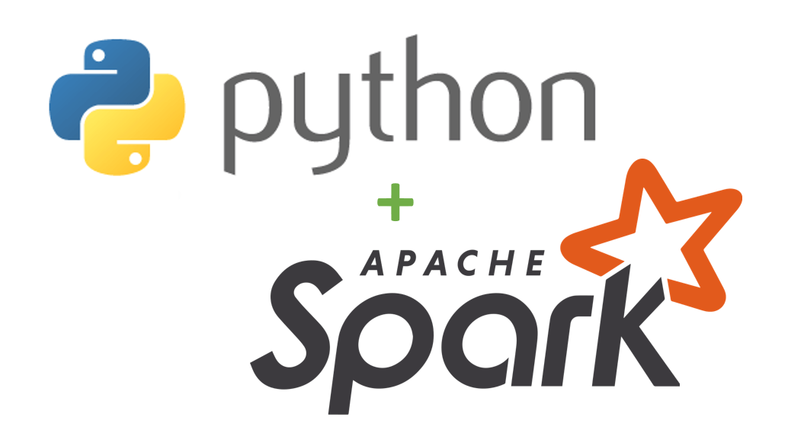
Setup Apache Spark and PySpark
Downloading Apache Spark:
Apache Spark website (https://spark.apache.org/downloads.html).
Setting Up Spark Environment:
Setting the ‘SPARK_HOME’ environmental variable to the installation directory
Adding Spark’s ‘bin’ directory to my system’s ‘PATH’ to easily access Spark’s command
PySpark:
The Python API for Apache Spark.
Installing PySpark:
pip install pyspark

Slide 8
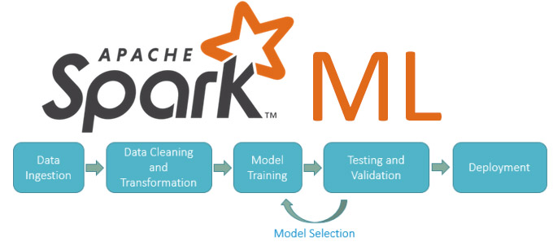
Spark Machine Learning Model
In this project, Spark's Mllib has been utilized to build a machine learning model for MI prediction.
The dataset has been loaded into Spark, and it has been split into training and testing sets.
Several machine learning algorithms have been explored, and finally logistic regression has been used to classify the dataset.
Logistic regression is a straightforward yet effective approach for this task, making it a suitable choice for predicting heart attacks based on the provided data.

Slide 9
Dataset
The heart attack dataset used in this project The dataset has
13 features
303 instances
This dataset is open source and freely available on Kaggle. The link to the dataset is
https://www.kaggle.com/datasets/rashikrahmanpritom/heart-attack-analysis-prediction-dataset.
The data was preprocessed to
handle missing values
convert categorical variables to numerical format
scale numerical features as required

Slide 10
Dataset
Feature Name | Description | Values
age | Age of the person in years | Integer
sex | Gender of the person | Female = 0
 |  | Male = 1
cp | Chest pain type | asymptomatic = 0
 |  | typical angina = 1
 |  | atypical angina = 2
 |  | non-anginal pain = 3
trestbps | Resting blood pressure | in mm Hg on admission to the hospital
chol | Serum cholesterol fetched via BMI sensor | in mg/dl
fbs | Fasting blood sugar > 120 mg/dl | False = 0
 |  | True = 1
restecg | Resting electrocardiographic results | Hypertrophy = 0
 |  | Normal = 1
 |  | having ST-T wave abnormality = 2
thalach | maximum heart rate achieved | Integer
exang | exercise induced angina | No = 0
 |  | Yes = 1
oldpeak | ST depression induced by exercise relative to rest | Float
slope | the slope of the peak exercise ST segment | Downsloping = 0
 |  | Flat = 1
 |  | Upsloping = 2
ca | number of major vessels (0-3) colored by fluoroscopy | Integer
thal | A blood disorder called thalassemia | Null = 0
 |  | Fixed defect = 1
 |  | Normal = 2
 |  | Reversible defect = 3

Slide 11
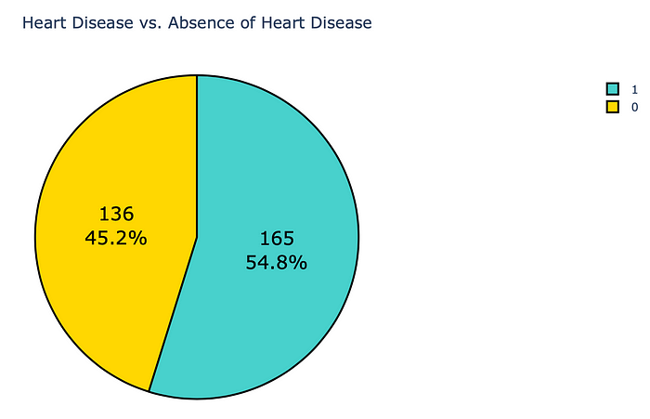
Dataset(Cont.)
In the dataset
136 people no have heart disease
labeled as 0
165 people have heart disease
labeled as 1
Sample Data
age | sex | cp | trtbps | chol | fbs | restecg | thalachh | exng | oldpeak | slp | caa | thall | output
63 | 1 | 3 | 145 | 233 | 1 | 0 | 150 | 0 | 2.3 | 0 | 0 | 1 | 1
37 | 1 | 2 | 130 | 250 | 0 | 1 | 187 | 0 | 3.5 | 0 | 0 | 2 | 1

Slide 12
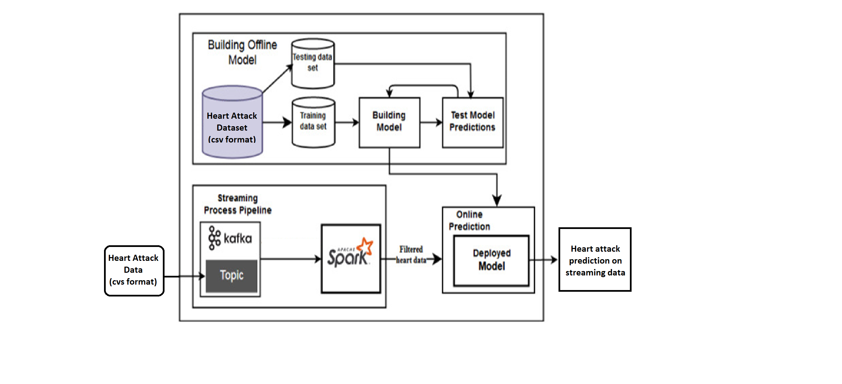

The architecture of heart attack prediction system
Building the offline model
Logistic regression, a classification algorithm, has been used for classification
Evaluation method is accuracy
Streaming processing pipeline
Data has been collected from a csv file and sent to Kafka Topic.
After that, Spark has read the streaming data from Kafka Topic.
Online prediction
The developed model has received the data and predicted whether the data contains indications of heart disease or not.

Slide 13
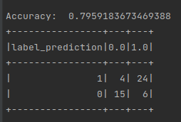
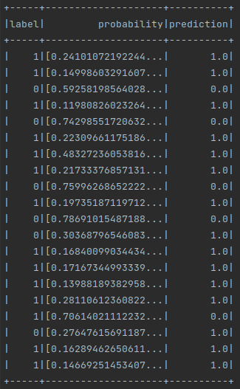
Model Generation and Storage Layer:
The data has been loaded form CSV file into a DataFrame.
A pipeline has been created, consists of three stages.
Vector assembler
MinMaxScalar
Logistic Regression Model
Logistic Regression has been used for binary classification with following parameters:
maxIter = 1
regParam = 0.1
Accuracy of the model is 79.59%

Slide 14
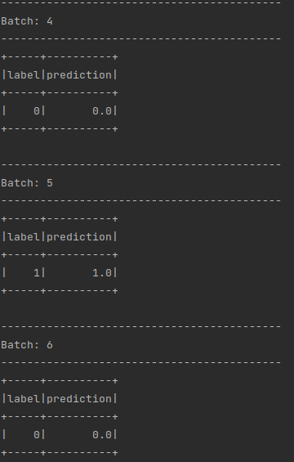
Real-Time Prediction
Kafka Producer:
The CSV file containing the heart attack data has been used as a Kafka producer.
It has sent individual records (rows) of data to a Kafka topic at regular intervals, simulating real-time data ingestion.
Kafka Consumer (Spark Streaming):
Spark Streaming has been used as a Kafka consumer to receive data from the Kafka topic. Spark has maintained a continuous stream of data, allowing real-time processing.
Feature Extraction:
Each incoming record from Kafka has been preprocessed in Spark to align with the training data's format,
Real-Time Prediction:
The preprocessed data has been then fed into the pre-trained machine learning model.
The model has predicted the likelihood of a heart attack for each incoming record in real-time.

Slide 15
Conclusion
Successful implementation of a real-time heart attack prediction system using Apache Kafka and Apache Spark has been demonstrated.
By combining Kafka's data streaming capabilities and Spark's distributed data processing, we have created an efficient and scalable pipeline for real-time prediction.
A dataset has been constructed from 303 (80% to build model and 20% as real-time) persons health features have been utilized to build up the prediction model
An accuracy of 79.59% has been achieved for this model.
With this system, healthcare professionals can potentially identify and intervene in heart attack cases promptly, saving lives and improving patient outcomes.
The real-time heart attack prediction system can be extended to other healthcare domains, such as predicting other medical conditions or monitoring patient vitals in real-time.
Future improvements can be made to enhance its accuracy and performance (i.e. building bigger dataset).

Slide 16
Thank You

